Slide 1


ONLINE BOOK STORE MANAGEMENT
Submitted by :
Gokeda LAHARI Sai Durga.
Mallimoggala durga Sagar.
sri varsha.
UNDER THE GUIDANCES OF :
Mrs .KAMATCHI CHANDRAN MA’AM

Slide 2
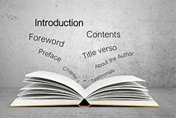
Content
Introduction
Objectives
Technologies used
System architecture
Features for customers
Admin features
Database design
Security
Search & filtering
Scalability & maintainability
ER diagram & outputs
conclusion

Slide 3

Introduction
The Online Book Store Management System is a web-based platform designed to simplify bookstore operations.
It enables users to search, browse, and purchase books online.
The system also provides an admin panel for managing inventory, processing orders, and generating reports.
Built using Spring Boot, it ensures a smooth user experience with a focus on security and scalability.

Slide 4
Objectives
Develop a responsive application: Ensure a user-friendly interface for both customers and administrators.
Secure authentication & authorization: Protect sensitive data through login mechanisms and role-based access.
Manage a large catalog of books: Offer efficient search and filtering options for easy navigation.
Streamline transactions: Allow customers to add books to the shopping cart, proceed to checkout, and make secure payments.
Admin tools: Provide capabilities for managing books, tracking sales, and generating insightful reports.
Ensure scalability: Design the system to accommodate future growth and easy integration of new features.The Online Book Store Management System is a web-based platform designed to simplify bookstore operations.

Slide 5
Technologies used
Spring Boot: Backend framework for building scalable web applications.
Spring MVC: Manages the web application's requests and views.
Spring Data JPA: Simplifies database interactions and data persistence.
Thymeleaf: Server-side templating engine used to dynamically render HTML.
H2 Database: Lightweight, in-memory database for quick development and testing.
Maven: Manages dependencies and builds the project efficiently.
Git: Version control to track code changes and collaborate.Backend: Spring Boot, Spring MVC

Slide 6
System architecture
User Interface: Built using Thymeleaf, which handles dynamic content rendering.
Controller Layer: Spring Boot’s controllers manage HTTP requests from the frontend.
Service Layer: Contains business logic, coordinating data flow between the frontend and backend.
Data Layer: Spring Data JPA manages interaction with the H2 database for persistence.
Database: H2 database stores data related to books, users, and orders.

Slide 7

Data Flow Diagram
user
Frontend (thyme leaf)
Backend (spring boot)
Data access layer( SD JPI)
Data base (H2)

Slide 8
Features of customers
User Authentication: Secure login and registration for customers.
Book Browsing: Search for books by categories such as genre, author, or title.
Shopping Cart: Add selected books to a cart and modify it before purchase.
Checkout Process: Secure payment system to complete orders.
Order History: Customers can view and track previous purchases.

Slide 9
Admin Features
Manage Books: Admins can add, edit, or delete books from the inventory.
User Management: Admins can view, update, and delete user accounts.
Order Management: Admins can view and process customer orders.
Report Generation: Admins can generate reports on sales, inventory, and user activity.
Secure Access: Admin features are protected through role-based access control.User Management:

Slide 10
Database, Security, Search & Scalability
Database Design:
Key tables: Users, Books, Orders, Categories.
Relationships between users, orders, and books for efficient data management.
Security:
Role-based access control (admin and customer).
Encrypted passwords and secure data transmission.
Search & Filtering:
Search by title, author, or category.
Filter books by price, genre, etc.
Scalability:
Modular structure for easy updates.
Spring Boot enables future growth and smooth performance under high load.Security

Slide 11
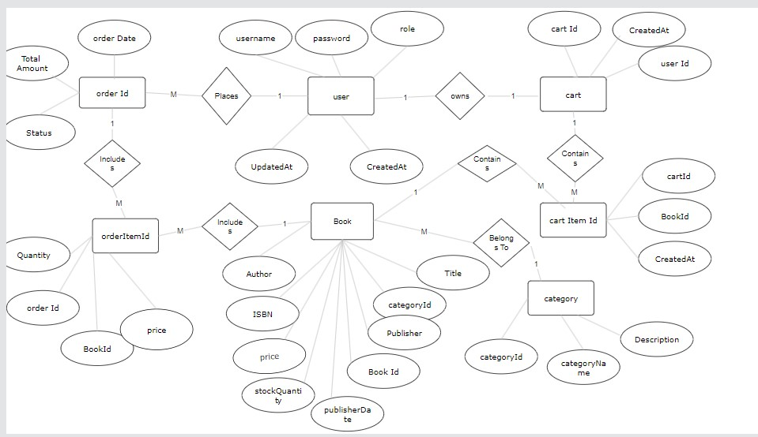
Er diagram

Slide 12

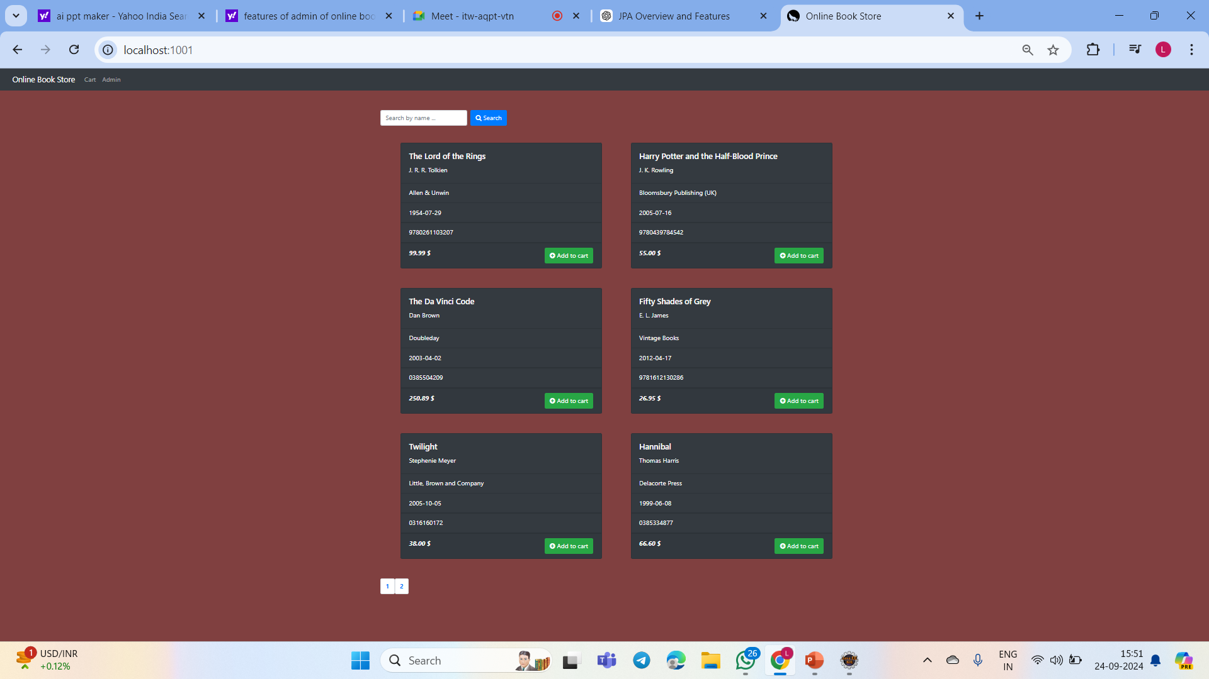
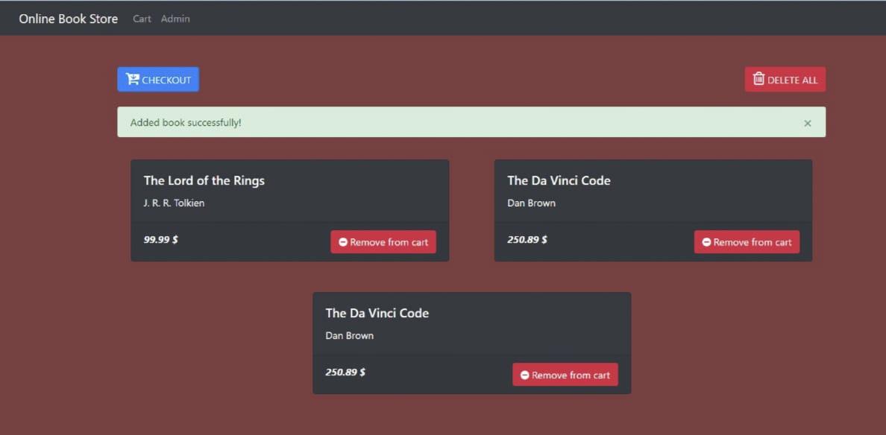
output
Login Form
Books List
Added Books in a cart

Slide 13
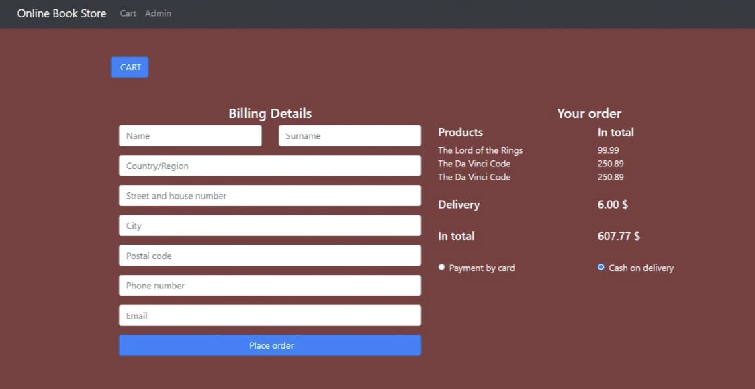
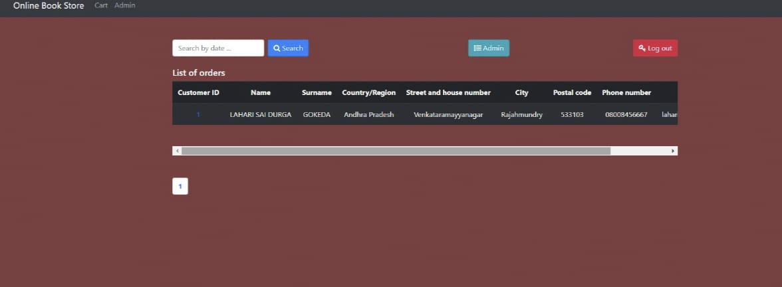
Billing Details
List of Orders

Slide 14

conclusion
The Online Book Store project provides a comprehensive and user-friendly platform for both customers and administrators, offering efficient book browsing, secure transactions, and streamlined inventory management.
Built on a robust Spring Boot architecture, the system ensures scalability, security, and maintainability for long-term use.
With features like role-based access control and an intuitive interface, the system caters to both end-users and admins, ensuring smooth operations.
This project serves as a scalable foundation for future growth and enhancements in an online retail environment.

Slide 15


